Slide 1

SKYTRAX AIRLINE REVIEW ANALYSIS
Rashad Ahammed
LinkedIn:Rashad-Ahammed

Slide 2
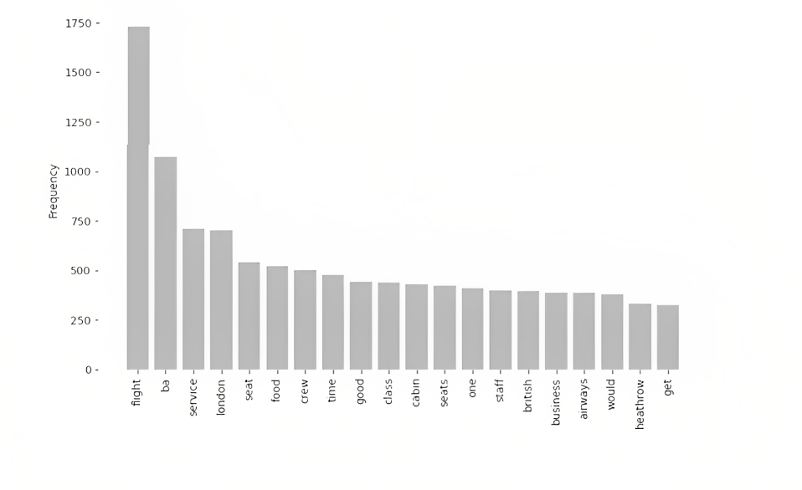
What we see in data
The frequency graph below demonstrates that service, seat, crew and staff are among the primary subjects within the evaluations, demonstrating that passengers are actively discussing their experiences and staff.

Slide 3
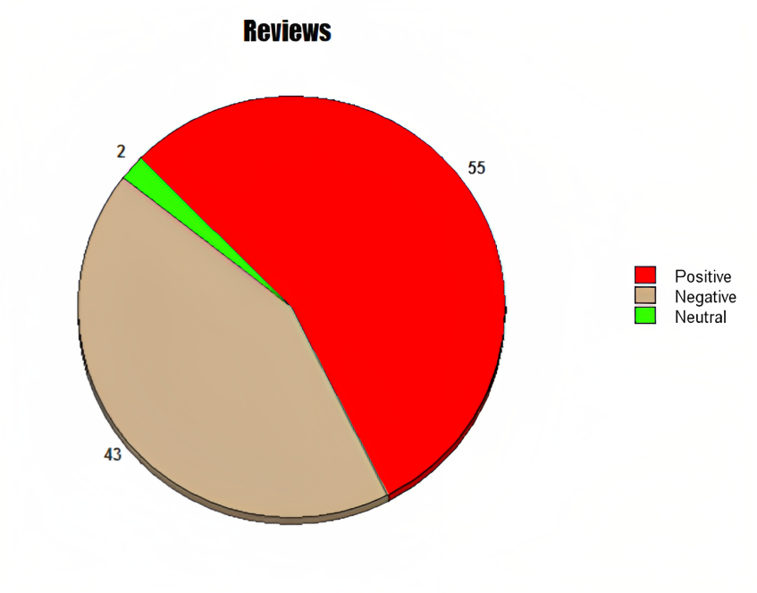
What we see in data
Out of 1000 reviews, 546 were positive, 437 were negative and 17 were neutral. This means the majority of reviews were polarised as either positive or negative.

